Slide 1
Promoting a Dignified Workplace
(Line Manager Presentation)

Slide 2
Learning Outcomes
Understand the importance/benefits of having policies
to combat bullying and harassment and promote dignity at work
Understand the roles and responsibilities of the line manager/Principal and employees
Be able to identify unacceptable behaviour
Understand the difference between bullying and harassment
Awareness of approaches to dealing with unacceptable behaviour

Slide 3
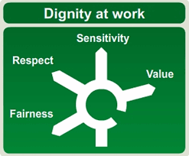
Why is Dignity at Work Important ?
It is important for every employer to be aware that they are obliged to provide a work environment free from unacceptable behaviour.
Time spent on the promotion of dignity at work policies is often better than the time spent on dealing with individual complaints.
Notes:
As a part of the EA values everyone should be treated with dignity and respect. The goal is to create a culture that fosters dignity at work.
Promotion of dignity at work:
Focuses on prevention and ensuring that people have an awareness and understanding of the policies of what is acceptable and what is not acceptable in the workplace.
Ensures the protection of the health, safety and wellbeing of all staff, as is the employers duty of care.
Ensures that all staff are made fully aware of their rights and responsibilities.
Ensures that allegations of bullying and harassment are dealt with seriously, sensitively and in confidence.
Ensures that all the necessary training in managing the policies is provided and everyone is aware of the policies available.
Complaints must be dealt with properly seriously and promptly. Disciplinary action should be taken where appropriate. Employers can rely on the statutory defence that they took all reasonable steps to prevent such negligence if they can show they had taken relevant actions prior to the act occurring eg
training staff on policies and procedures
following good practice and employees having access to the policies and procedures
issuing appropriate sanctions for failure to comply with the existing policies as appropriate
communicating effectively eg personally, verbally, face to face etc

Slide 4
Promoting a Dignified Workplace
EA Values
Joint Declaration of Protection
Social Media Policy
Dignity at Work Policy & Code of Practice
Equal Opportunity Policy
Acceptable use of ICT Policy
Health & Safety Policy
Notes:
The Dignity at Work policies are supported by a number of other policies/documents to ensure the dignity of all EA employees.
EA Values – As a part of our values we expect you to treat everyone with dignity and respect, promote equality of opportunity and behave professionally – this will allow all employees to work in a dignified workplace. Reflection, Respect, Equality, Responsibility, Openness, Excellence
Social Media Policy – prevents unlawful discrimination, harassment and bullying by clearly outlining the responsibilities of EA employees in the use of social media, including Facebook, LinkedIn, Twitter etc in both business and personal use. The policy provides guidance to employees and specifically notes “ Respect colleagues, clients, partners and suppliers” and do not post anything others would find offensive, including discriminatory comments, insults and obscenity. There are increasing examples of employees posting on social media that has resulted in dismissals across the UK – remember you should apply the same standards of conduct online as you are expected to apply offline. “Think once before you act, twice before you speak, and three times before you post on Facebook.” Paul Brunson
Acceptable use of ICT Policy – This policy outlines standards of acceptable use which are in line with the Health & Safety and Anti-discrimination legislation. Examples includes inappropriate material and remarks which could breach discrimination laws or offend any ‘protected characteristic’ e.g. sex, race, religion, disability etc., pictures, cartoons, words, sounds or moving images.
Health & Safety Policy – Health and safety is a key responsibility for all managers and is a shared responsibility for all employees. The EA’s objective is to provide and maintain as safe and healthy working environment for all its employees in accordance with health and safety law. Employers have a duty of care to all employees which is clearly demonstrated in the health and safety policy. In the context of a dignified workplace this relates to a safe working environment that is free from harassment, bullying and discrimination.
Equal Opportunity Policy – EA is committed to creating an organisation which recognises the contribution of all those who work for it, and which is supportive, fair and free from unlawful or unfair discrimination or harassment.
Joint Declaration of Protection – this declares that everyone has the right to work in work in a harmonious and inclusive environment, regardless of gender, disability status, religion, race, sexual orientation or any other protected characteristic. There is an expectation that Managers work towards creating inclusive cultures and working environments, where staff feel welcome and can apply their diverse talents, ensuring that no employee experiences discrimination or harassment.

Slide 5
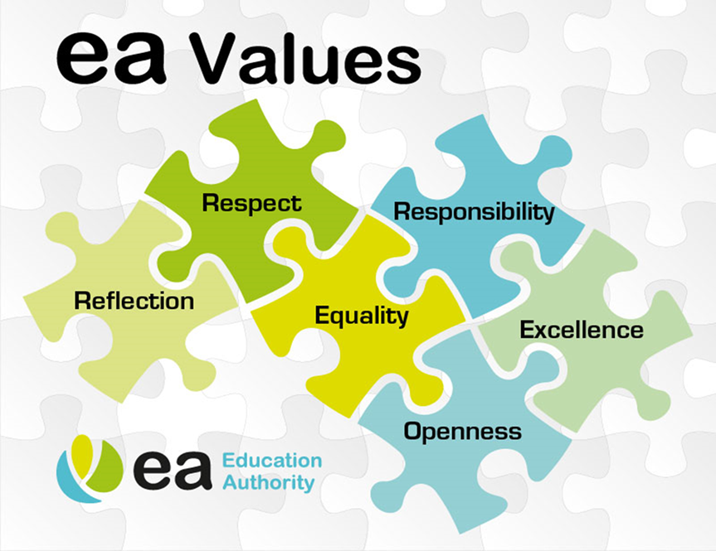
Joint Declaration of Protection June 2018
Everyone has the right to:
  equality of opportunity in employment
  work in a harmonious and inclusive environment, regardless of gender, disability status, religion, race, sexual orientation or any other protected characteristic
Managers/Principals should work towards creating inclusive cultures and working environments, where staff feel welcome and can apply their diverse talents, ensuring that no member of staff experiences discrimination or harassment
Notes:
EA are actively promoting an inclusive culture and working environment, which is evident through the:
Disability Staff Network
LGBT+ and Friends Network
EA have signed up to become a Diversity Champion with Stonewall.
Stonewall work with over 750 of the UK’s leading organisations to create fully inclusive environments for staff, services users and the wider community.
The Diversity Champions Programme is a leading employers’ programme for ensuring all Lesbian, Gay, Bisexual and Transgender (LGBT) staff are accepted without exception in the workplace.
This is one part of EA’s diversity and inclusion approach, helping us to deliver focused interventions that support and enhance diversity in the workplace, particularly for our LGBT colleagues.
We believe that no one should have to ‘edit’ themselves when they come to work.
EA Values which guide our behaviours:
Openness – to promote a culture of openness and be transparent and honest in our dealing with the public, our partners and colleagues
Respect - to listen and respect those we serve, as well as each other and will recognise effort, achievement and contribution.
Reflection - we are a learning organisation, reflecting and taking on board the lessons learned from our own experiences
Responsibility – to act responsible and acknowledge that actions will impact on others. To be helpful, conscientious, reliable and accountable for all our actions.
Excellence - to strive for quality in everything we do. To behave professionally and take pride and ownership for everything we say and do.
Equality – to promote equality of opportunity through our employment practices, service delivery and engagement activities.
All of the above are reflected throughout the various policies and procedures and support a dignified workplace.

Slide 6
Benefits of Having a
Dignity at Work Policy
Treating dignity at work as a serious issue and following the correct policy and procedure is likely to have the following benefits:
Higher morale and improved performance
More productive workforce
Create a more positive working environment for employees and better staff retention
A positive impact on the wellbeing of all staff and reduced absence levels
Improved service delivery
Better industrial relations
Notes:
Treating dignity at work as a serious issue is likely to have the following benefits:
• Higher morale and improved performance
Giving employees a more positive working environment improves morale and has a consequent impact on productivity. Relaxed, happier staff are more productive and this relates to the whole workgroup, not just those immediately affected by bullying or harassment issues.
• Reduced turnover and better staff retention rates
Employees frequently choose not to remain with the organisation when they can resolve their issues by resigning. Research indicates that approximately 50% of those who are targets of bullying and harassment leave the organisation rather than using internal procedures to resolve the situation.
• Reduced absence levels, particularly stress related
Bullying and harassment are likely to lead to stress related illnesses. Effectively tackling these issues is likely to improve sickness absence rates.
• Improved service delivery
If employees are treated fairly and well by their employer, they are far more likely to behave in a positive way towards other stakeholders.
• Better industrial relations
Organisations that have an effective strategy to deal with bullying and harassment are far less likely to have constant difficulties.
Bullying, harassment and victimisation can lead to stress, sickness, absence, low productivity, weakened morale, dysfunctional conflict, damaged interpersonal relationships and litigation.
Employers have a duty of care towards workers, and therefore have a responsibility to prevent harassment and bullying in the workplace. An employee who is being harassed or bullied can raise a formal complaint.
A formal complaint will have an overall impact on the wellbeing of staff involved and working relationships with possible consequences some of which could potentially lead to:
Internally Externally
Disciplinary Action Legal Action
(Gross) misconduct, Criminal Action
(Action short of or) Dismissal Civil Action

Slide 7
Roles and Responsibilities of the:
Line Manager/Principal
Employee
Communicate and promote awareness of the policy to employees
Ensure that unlawful discrimination, harassment, bullying or victimisation does not occur
Set a good example
Ensure any complaint is treated seriously, sensitively and in confidence
All employees have a responsibility to co-operate in the ‘promotion of harmonious working relationships’
To comply with relevant policies
Ensure that their behaviour to colleagues does not cause offence and could not in any way be considered to be unacceptable
Notes:
All employees are required to co-operate in the promotion of harmonious working relationships within the workplace.
We all have a role and responsibility to ensure that unacceptable behaviour on any of the grounds laid out in the policies will not be tolerated and all employees are treated with dignity and respect.
All employees must comply with this policy and ensure that their behaviour does not cause offence to fellow workers or any person with whom they come into contact during the course of work.
Employees should discourage bullying and harassment by objecting to inappropriate behaviour.
Employees should inform a manager or supervisor if the are concerned or aware that a colleague is being bullied or harassed.
Each member of staff carries responsibility for his or her own behaviour.
Employers have a duty to prevent harassment taking place.
Managers/Principals have a responsibility to set the standards of acceptable behaviour expected of staff. This includes using their judgement to correct standards of conduct or behaviour which could be seen as harassment, and to remind staff of these standards.

Slide 8
What is unacceptable behaviour?
Notes:
In the context of dignity at work and combating bullying and harassment, unacceptable behaviour includes;
Bullying which can be indirect or direct (indirect could be when one person, or group of people, undermines or tries to ruin a reputation by spreading rumours and gossiping behind someone’s back).
Harassment or Discrimination on the grounds of gender, disability status, religion, race, sexual orientation, age.
Victimisation which occurs when a person asserts their rights under equality legislation e.g. making a complaint, assisting a person making the complaint in good faith is treated less favourably as a consequence of doing so. Therefore a person who makes a complaint or has assisted an individual in pursuing a claim, or has acted as a witness in any investigation relating to bullying and harassment should be protected from acts of victimisation or retaliation.

Slide 9
Harassment
Harassment usually occurs where a person is subjected to unwanted conduct in relation to an equality ground with the purpose or effect of creating an environment which is hostile, degrading, humiliating, offensive or intimidating.
Harassment, can occur even if the conduct is not intended to be offensive.
    “I didn’t mean to offend anyone” – not an excuse!

Slide 10
Legislation
Sex Discrimination (NI) Order 1976
Fair Employment & Treatment (NI) Order 1998
Race Relations (NI) Order 1997
EQUALITY LAWS
Employment Equality (Age) Regulations (NI) 2006
Employment Equality (Sexual Orientation) Regulations (NI) 2003
Disability Discrimination Act 1995
Notes:
Sex Discrimination – harassment on the grounds of sex. Discrimination against women on the grounds that they are or were pregnant during a protected period ie (when a women becomes pregnant and continues to the end of statutory maternity leave).
Fair Employment - harassment on the grounds of religious belief and political opinion. It also refers to the perception of perceived religious belief (correctly or incorrectly because you believe a person to be of a particular religious belief).
Employment Equality (Age) - harassment on the grounds of age, including perceived age.
Disability Discrimination Act 1995 – harassment which relates to the person’s disability. Discrimination on the basis of disability, either direct discrimination, failure to comply with duty to make reasonable adjustments, disability related discrimination or victimisation. A disability is defined as a “physical or mental impairment, which has a substantial and long term adverse effect on a person’s ability to carry out normal day to day activities”. Disabilities can also be invisible e.g. mental health/autism and therefore it can be difficult to visibly see a disability.
Employment Equality (Sexual Orientation) – harassment on the grounds of sexual orientation. Discrimination towards people of the same sex, or people of the opposite sex, , or people of the same or opposite sex e.g. gay, lesbian, bisexual and straight. It also covers perceived sexual orientation because a person believes (correctly or incorrectly) that a person is gay, lesbian, etc.
Race Relations - harassment on the grounds of race, ethnicity or national origins. The legislation also covers Irish Travellers.

Slide 11
Harassment
Many forms of misbehaviour may amount to harassment, examples include:
  Physical conduct - assaulting a person or making obscene gestures;
  Verbal conduct - making racist, sexist, sectarian or homophobic/transphobic remarks/jokes/comments; making derogatory comments about a person’s age or disability; singing songs; gossip and slander; mobile telephone ring tones; and threats;
  Visual or written material - containing racist, sexist, sectarian, homophobic/ transphobic or other derogatory words or pictures (e.g. posters, graffiti, letters, emails, screen saver);
  Isolation or non-co-operation at work, exclusion from work-related social activities;
  Coercion - forcing a person to offer sexual favours or to take part in religious or political activities;
  Intrusion - by pestering, spying or following.
  Harassment can be an isolated ‘one-off’ event
Notes:
Consider the impact on the recipient rather than the intention of the alleged harasser.
Harassment may be against one or more people and may involve single or repeated incidents across a wide spectrum of behaviour, ranging from extreme forms of intimidation, such as physical violence, to more subtle forms such as ignoring someone. It can occur without witnesses, and take place in face-to-face interactions, as well as online. Examples include:
Aggressive or abusive behaviour such as shouting or personal insults
Spreading malicious rumours or gossip, or insulting someone
Unwanted physical contact
Publishing, circulating or displaying pornographic, racist, sexually suggestive or otherwise offensive material/pictures
Sending someone to Coventry
Questioning ability due to age
Making assumptions about someone’s ability purely on their disability or perception about their disability
Refusing to treat a person as their new gender once the reassignment process is complete

Slide 12
Bullying
  Bullying is similar to harassment in the sense that it too is offensive, hostile or oppressive behaviour; it may be because of jealousy or personal dislike or revenge or insecurity. and it can be;
  threatening, aggressive or intimidating
  abusive, insulting or offensive
  cruel or vindictive
  humiliating, degrading or demeaning.
  The main difference is that bullying behaviour need not be related to an equality ground, but may be for some other reason.
  If any examples cited previously are not related to an equality ground covered by anti- discrimination legislation, then it could amount to bullying.
Notes:
Bullying may be against one or more people and may involve single or repeated incidents across a wide spectrum of behaviour, ranging from extreme forms of intimidation, such as physical violence, to more subtle forms such as ignoring someone. It can occur without witnesses, and take place in face-to-face interactions, as well as online. Examples include:
Persistent and unreasonable criticism
Unreasonable demands and targets
Overbearing supervision or other misuse of power or position
Ridiculing or demeaning someone – picking on them or setting them up to fail
Making threats about job security
Preventing individuals progressing by intentionally blocking promotion or training opportunities
Copying emails that are critical about someone to others who do not need to know
Deliberately undermining a competent worker by overloading and constant criticism
There is a distinction between effective management and bullying. It is important to recognise the distinction between effective, robust management, which is necessary, and bullying, which is unacceptable.
An effective manager enables employees to meet high expectations by:
setting clear and agreed objectives and targets;
recognising and rewarding good performance;
providing honest and constructive feedback;
dealing appropriately with poor performance informally and/or formally, through procedures;
encouraging clear and open communication;
accepting responsibility and sharing credit;
being fair and consistent in all dealings;
valuing diversity and difference; and
dealing with conduct issues promptly and decisively in accordance with policy and procedure.

Slide 13
Key Differences
Harassment
Bullying
Related to social identity
Can be a ‘one off’
Anti-discrimination laws protect
Recognition of harassment is usually straight forward
Protection from victimisation
Is social identity (equality ground) neutral
Tends to be a series
No specific legislation exists to ban bullying
Can be difficult to recognise/ identify
No equivalent protection
Notes:
While bullying and harassment will always be deemed unacceptable behaviour the two terms have distinct meanings, although they are similar in relation to impact.
One person’s friendly banter can be another’s verbal harassment; one person's assertive management style can be another's overt bullying.
When dealing with harassment or bullying it can never be taken as, ‘I perceive myself as harassed or bullied therefore I am’; because although the impact on the recipient is crucial component it is not the sole criterion.

Slide 14
Victimisation
Distinct form of discrimination
Narrow definition - being picked on due to involvement in some capacity
Example of legal definition – ….a person (‘A’) discriminates against another person (‘B’) if he/she treats B less favourably than he/she treats others in the same circumstances and does so because B has… brought proceedings against A or any other person, given evidence/information in connection, alleged A has committed an act contravening the Regulations…….
Notes:
An example would be under the Employment Equality (Sexual Orientation) Regulations (Northern Ireland) 2003 (Part 1 (4)).
Employee who makes a complaint in good faith should be protected from acts of victimisation.

Slide 15
Banter
Ah, sure it’s only a bit of banter….
Sure, I was only slaggin’!
Oxford Dictionary definition is:
  Humorous ridicule; good-humoured personal remarks
  Make fun of
  Talk jestingly
Banter, however innocent, has potential for mischief. What is ‘banter’ for some, may be intimidating or embarrassing to others. What is ‘banter’ today, may be dangerous tomorrow.
There should be no place in the workforce for conduct that has the potential to disrupt the harmonious working environment or to intimidate or embarrass any worker or his/her religious or political opinions. (arising Grimes-v-Unipork Ltd (1992) Fair Employment Tribunal)
  This applies to all equality grounds
Notes:
Banter is part of Northern Ireland’s culture however the point is to be cautious with banter “as one person’s banter maybe another person’s harassment” it is about perception.
The definition of banter relates to humour and fun, however banter in the context of Dignity at Work can have a different implication as it does not relate to humour.
There is no overlap between banter and sexism, racism, homophobia etc.

Slide 16
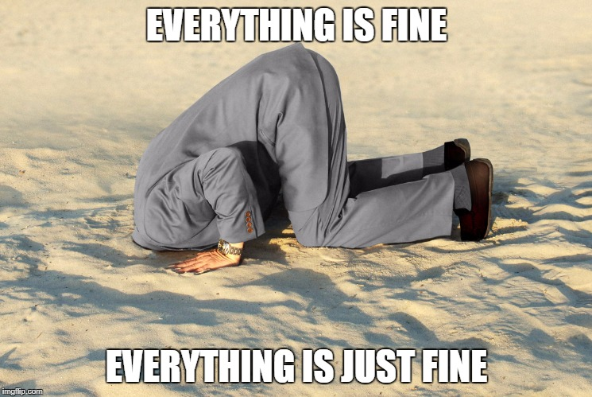
Notes:
Don’t put your head in the sand ………… If a situation arises, take it seriously and address it or seek help from the HR Employee Relations (Casework) team.
Focus on promotion of prevention of any occurrences of bullying and harassment in the workplace.
Managers and staff should be conscious of their own behaviour and should not engage in unacceptable behaviour and should prevent it happening or continuing.

Slide 17
Informal & Formal Approach
Informal resolution is a very effective way to deal with a complaint and restore effective working relations between the parties concerned as quickly as possible.
Employees have a number of options available:
  Approach the person directly; or
  Seek confidential advice, assistance or support of their line manager, trade union representative, or a fellow officer; or
  Mediation –an agreed process entered into voluntarily, in which an independent experienced intermediary assists participants who are in dispute.
The formal procedure can be used when it is either impractical to reach an informal resolution and/or the nature of the alleged unacceptable behaviour requires a more formal approach.
Notes:
If an employee approaches the Line Manager with a complaint, offer and outline options available:
Employees should be encouraged to try and resolve the issue informally in the first instance, the earlier the better, by approaching the person directly;
They can approach their line manager, trade union representative, a fellow officer or seek advice from human resources;
Mediation is available free of charge from the LRA – it is an effective means of resolving workplace disputes. The mediation process is confidential to the parties involved, non-legalistic and shall seek to reach an early resolution of the issues through consensus. It can be introduced at any stage of the formal procedure where the parties agree that engaging in the mediation process may resolve some or all of the issues.
It is recognised that sometimes the informal process is not appropriate because of the serious nature of the complaint therefore advice can be sought from the HR Employee Relations (Casework) team and the formal procedure may be invoked.

Slide 18
Exercises

Slide 19
Pauline feels that she has been the victim of bullying in the workplace and doesn’t feel able to talk to the individual involved about it. There are several steps she can take to deal with this situation.
In what order should she carry these out?
    Appeal against the decision
    Raise a formal complaint of bullying against the individual
    Speak informally to an appropriate person
    Attend a formal meeting to discuss her complaint
Notes:
Answer:
Speak informally to an appropriate person
Raise a formal complaint of bullying against the individual
Attend a formal meeting to discuss her complaint
Appeal against the decision
Pauline’s first response should be to try to sort the issues out informally by promptly talking to her line manager or another appropriate person. If this does not resolve the issue, she can raise a complaint under the relevant Dignity at Work Policy and Code of Practice and discuss the issues at a formal meeting. If she is not happy with the decision following investigation, she can appeal against it. She cannot, however, take the case to a Tribunal, as there is no legal protection against bullying.

Slide 20
Harry is approached by a member of his team, James, to say that he’s being harassed because of his age. He’s quite a bit older than his colleagues and John is furious that they would make jokes about him behind his back. Harry plans to get to the bottom of this and thinks about speaking to the team as a group (including James) straight away to put an end to this behaviour. Harry reflects on the situation and decides to have an informal approach to address the issue.
Why is it best to adopt a prompt, informal, ‘quiet word’ approach to issues of harassment and bullying instead of a ‘team meeting’ approach?
Select one or more options
    It protects and respects the feelings of the person carrying out the harassment or bullying
    It gives the person accused of harassment or bulling the chance to apologise
    It stops the situation escalating
    It avoids a potentially stressful and lengthy dignity at work complaint or disciplinary process
Notes:
Answer:
It gives the person accused of harassment or bulling the chance to apologise
It stops the situation escalating
It avoids a potentially stressful and lengthy dignity at work complaint or disciplinary process
In most cases, instances of harassment and bullying in the workplace can be dealt with effectively by informal means, with the matter remaining confidential between those immediately concerned. Holding an open meeting, could make things worse for the person raising the matter: the individuals concerned will probably resent being given a lecture and may decide to take their annoyance out on James – but less openly.

Slide 21
Which of the following statements about bullying is correct?
    Because of their position of authority only managers are in a position to carry out bullying.
    Because of their position of authority managers cannot be the victim of bullying by subordinates.
    Despite their position of authority managers can be the victim of bullying by subordinates.
    A manager's behaviour towards another manager can never amount to bullying.
Notes:
(Answer – C) there is no legal definition of bullying however it is not generally related to a social identity basis – bullying is offensive ,intimidating, malicious behaviour and can involve the misuse of power. However, power does not always mean being in a position of authority, but can include both personal strength and the power to coerce through fear of intimidation, e.g. inappropriate derogatory remarks about someone’s performance.

Slide 22
John makes it clear to his manager, Pete, that he finds the way his colleague Darren refers to the female members of the team as ‘the floozies’ offensive. Which of the following is correct?
    Pete has investigated the complaint but has been assured by Darren that the term is not meant to be offensive, so he need take no further action.
    As John is a man complaining that he finds a term used to describe his female colleagues offensive, there is no need for Pete to take any further action - the comments don't relate to John's sex.
    As the rest of the team members find the term amusing it is obvious that John is simply being oversensitive, so no further action is necessary.
    Pete should take immediate steps to put a stop to Darren referring to his female colleagues in this way.
Notes:
(Answer – D) The situation should be addressed immediately to prevent any further concerns and to ensure that all employees are treated with dignity and respect. This behaviour is not reflective of EA values, joint declaration or the expectations in the Dignity at Work Code of Practice
Banter can be a form of harassment and as already stated, one person’s banter maybe another person’s harassment.

Slide 23
Mary has complained to her manager that a colleague, Steve, sexually harassed her at the work Christmas party, which took place one evening in the local pub. Which of the following is correct?
    As the alleged incident happened outside normal working hours, Mary would have no possibility of success if she brought a complaint before a tribunal.
    Since the quiz was for a good cause, even if Steve is guilty of the alleged harassment, any tribunal is likely to view Mary's insistence on complaining about his behaviour in a bad light.
    Mary may be able to bring a successful tribunal claim even if Steve has not sexually harassed her on previous occasions during working hours.
    Although Mary's manager is concerned about her allegations, he can rest assured that, as no one at the company instructed Steve to behave in this way, the company is absolved of responsibility for his actions.
Notes:
(Answer C) Christmas parties, work social events that are carried out with work colleagues, whether officially organised by the employer or not, have generally been viewed as an “extension” of the workplace and as such normal rules of conduct and disciplinary rules will apply. An employer can be held vicariously (delegated) liable (as if they had committed the act themselves) for the actions of an employee if they were carried out in the “course of employment”. What constitutes in the “course of employment” can be very broad in terms of being closely connected with work.

Slide 24
CONTACTS – FURTHER ASSISTANCE
Employee relations advice and guidance is available from the HR Employee Relations (Casework) Team as follows:
South West | Contact Name & Number
Fermanagh and Omagh | Eugene McDermott Tel: 028 8241 1347 eugene.mcdermott@eani.org.uk
Mid Ulster
Armagh, Banbridge, Craigavon
East | Contact Name & Number
Newry Mourne and Down | Helen Mills Tel: 028 9056 6490 helen.mills@eani.org.uk
Ards and North Down
Lisburn and Castlereagh
Belfast
North | Contact Name & Number
Derry and Strabane | Phyllis Russell Tel: 028 2566 1194 pyhllis.russell@eani.org.uk
Causeway Coast and Glens
Mid and East Antrim
Antrim and Newtownabbey
Corporate Directorates | Contact Name & Number
Marina McAlary Tel: 028 8241 1340 marina.mcalary@eani.org.uk | Gabriel Mulryan Tel: 028 8241 1336 gabriel.mulryan@eani.org.uk

Slide 25
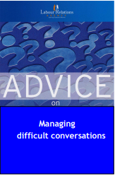

Helpful Guidance
Labour Relations Agency – Managing Difficult Conversations
Equality Commission/Labour Relations Agency – Harassment & Bullying in
the Workplace)
EA Tools & Templates (available from the HR Employee Relations Team)
Notes:
You can contact any of the HR Employee Relations team at the relevant offices and they will provide you with information and guidance in relation to the Dignity at Work toolkit.

